Slide 1

UNDERSTANDING YOUR HOME VALUE

Slide 2

Team MembersENDA
Jane Martha
James Njoroge
Leon Maina
Daniel Wahome
Magdalene Ondimu
Faith Mwenda

Slide 3

Understanding Your Home's Value:
Insights and Recommendations Agenda:
Introduction: Understanding the Factors Influencing Your Home's Value Model Performance:
How Reliable Are Our Predictions? Key Predictors:
What Influences Your Home's Price? Model Assumptions: Ensuring Accuracy Over Time Recommendations:
Maximizing Your Home's Value Next Steps: Enhancing Our Understanding Further

Slide 4
Executive Summary
Introduction: Understanding Your Home's Value Your home's value is influenced by various factors such as size, location, condition, and amenities. Our analysis aims to uncover the key drivers of house prices to help you make informed decisions.
Multiple linear regression modeling is used in this study to provide homeowners with useful information as they navigate the challenging real estate market. As market analysts specializing in real estate, our objective is to discern the intricate relationships among diverse property attributes and their impact on the selling price of properties. By exploring the King County House Sales data collection, we intend to provide homeowners with enlightening guidance on how to raise the estimated value of their homes by making thoughtful improvements

Slide 5
Executive Summary
Key Predictors: What Influences Your Home's Price? Larger Living Spaces: Properties with larger living spaces tend to have higher prices. Grade: Homes with a grade of 8 (Good) also command higher prices. Visualization: Scatter plot showing the relationship between living space and price, with different grades highlighted.
Model Assumptions: Ensuring Accuracy Over Time Our models meet important assumptions such as normality of residuals, homoscedasticity, and linearity. Regular monitoring of model diagnostics ensures ongoing accuracy. Visualization: Residual plots demonstrating the model assumptions.
Recommendations: Maximizing Your Home's Value Prioritize Upgrades: Consider investing in upgrades that increase living space or improve the overall grade of your property. Regular Maintenance: Maintain your home in good condition to preserve its value over time. Visualization: Bar chart showing the impact of different upgrades on home value.

Slide 6
Problem Statement
The main problem for homeowners is the failure in to make strategic decisions in investing for the proper renovation of their rental homes. The homes end up depreciating hence losing customers. The homeowners lack knowledge on how to be responsible owners and hence end up suffering a great loss.
Key Question
What are Assessment criteria, and policies for renovations
What factors are involved in renovations
How to optimize returns for homeowners

Slide 7
Problem Statement
The study aims to decipher the complex interactions between different property attributes and their impact on home sale price by utilizing multiple linear regression models.
The ultimate objective is to furnish market analysis with practical insights, augmenting their capacity to proficiently counsel homeowners in making critically better decision with the ultimate change in real estate

Slide 8
Data understanding
The dataset originate from King county house sale dataset
The rows and columns contain unique features.
The Key Features:
No of floors, waterfront, view, square footage, grade, condition.

Slide 9
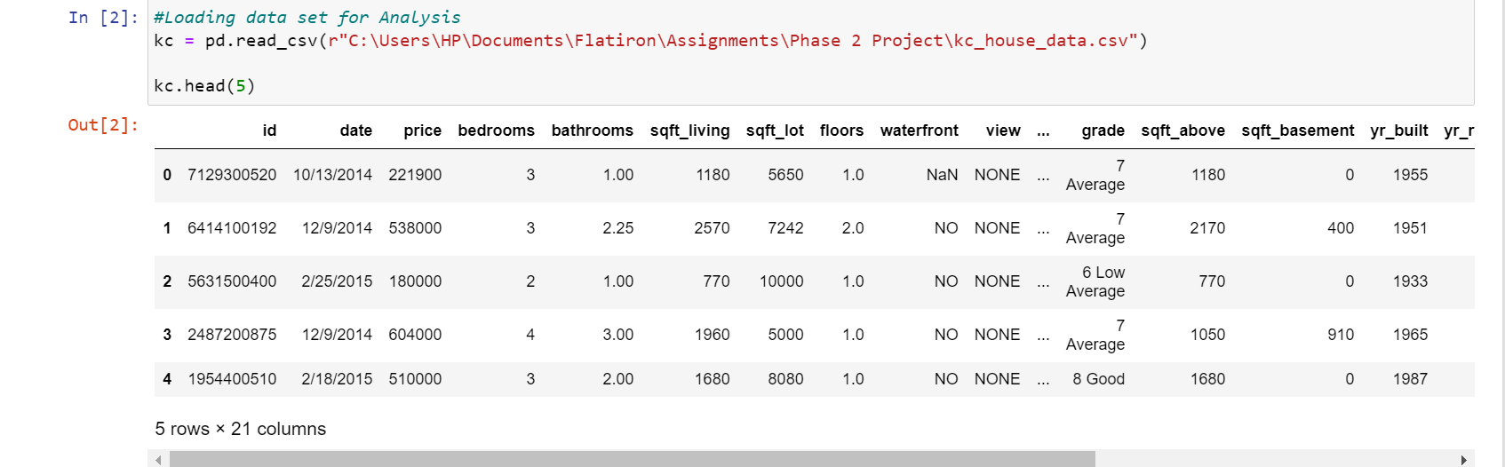
Data set

Slide 10
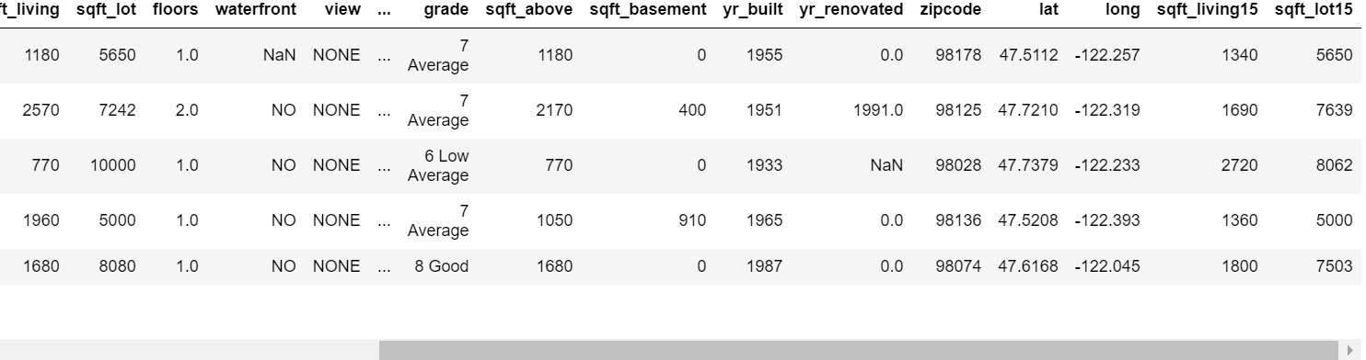
Data set

Slide 11
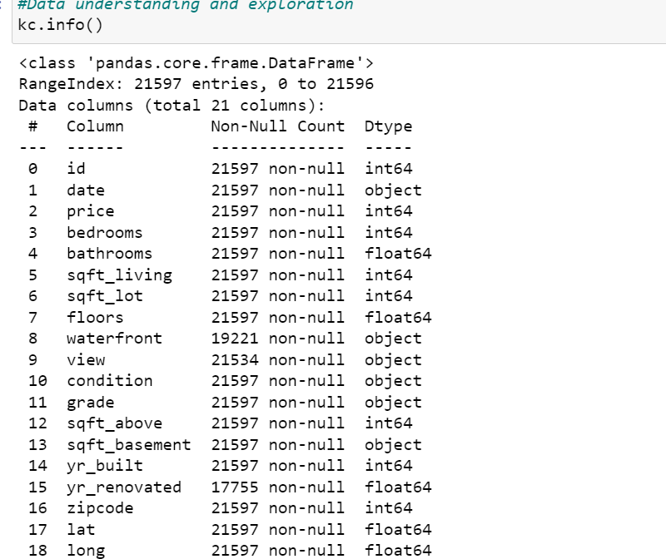
Data understanding

Slide 12
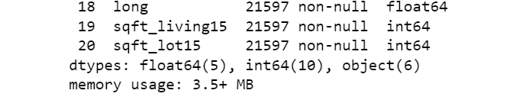
Data understanding cont’d

Slide 13

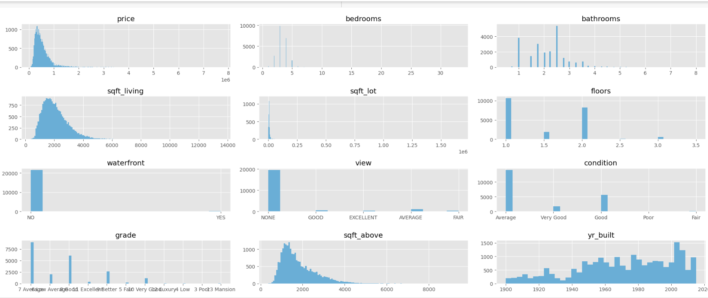

Slide 14
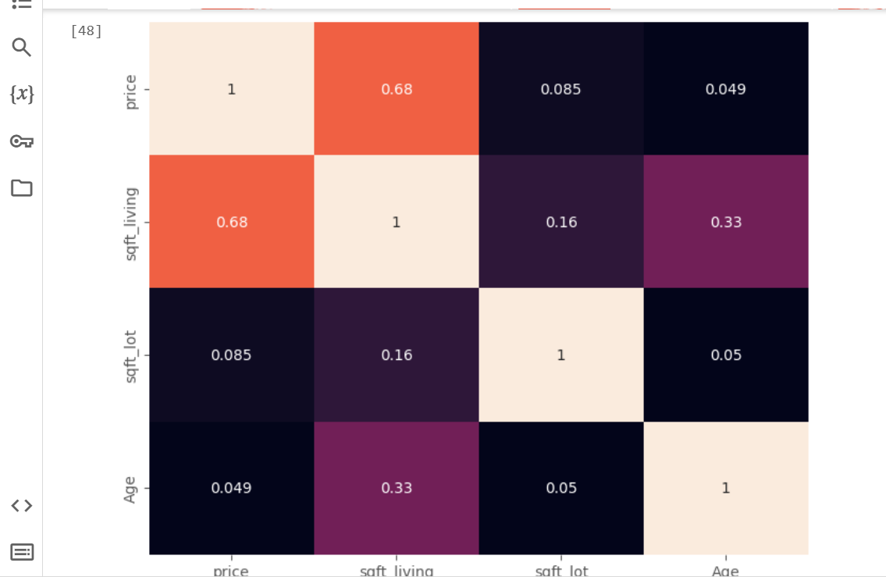


Slide 15
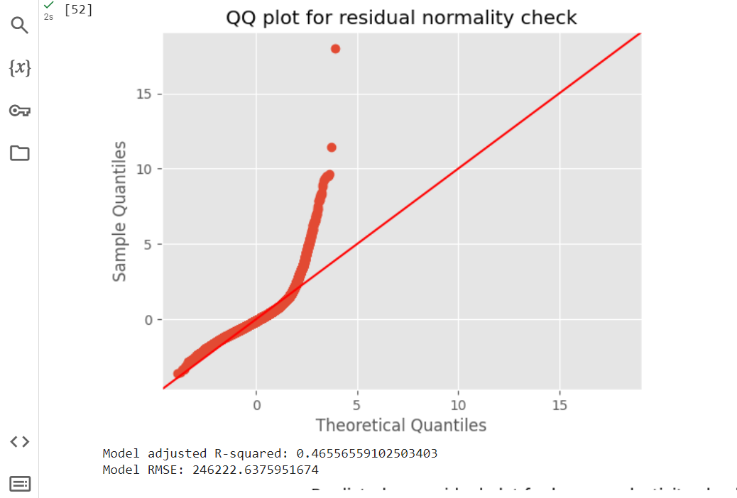

Slide 16
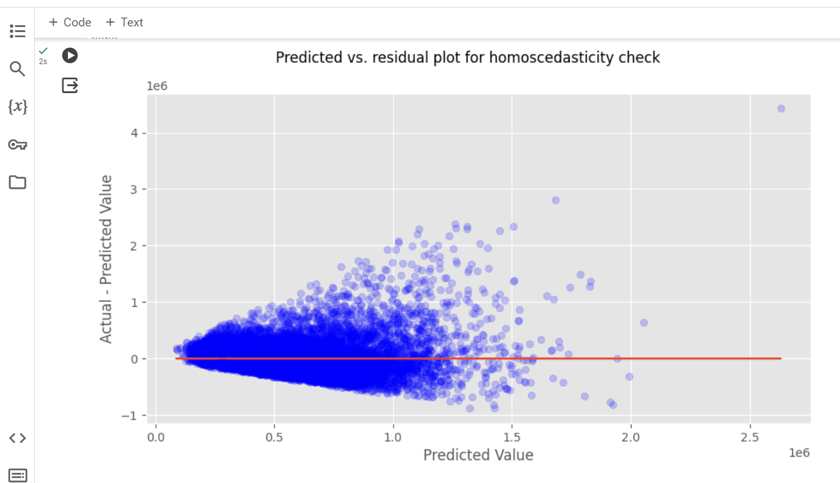

Slide 17
The coefficient for the constant term (intercept) is -9704.3054, indicating the predicted price when sqft_living is zero. The coefficient for sqft_living is 262.8635, indicating that for every unit increase in sqft_living, the price is expected to increase by approximately $262.86. The p-value for sqft_living is less than 0.05, indicating that the predictor variable is statistically significant. The confidence interval for the coefficient of sqft_living ranges from 259.088 to 266.639. The residual plots indicate that there might be some heteroscedasticity present, as the spread of residuals increases with predicted values. The QQ plot suggests that the residuals are approximately normally distributed, but there might be some deviations, especially in the tails.

Slide 18
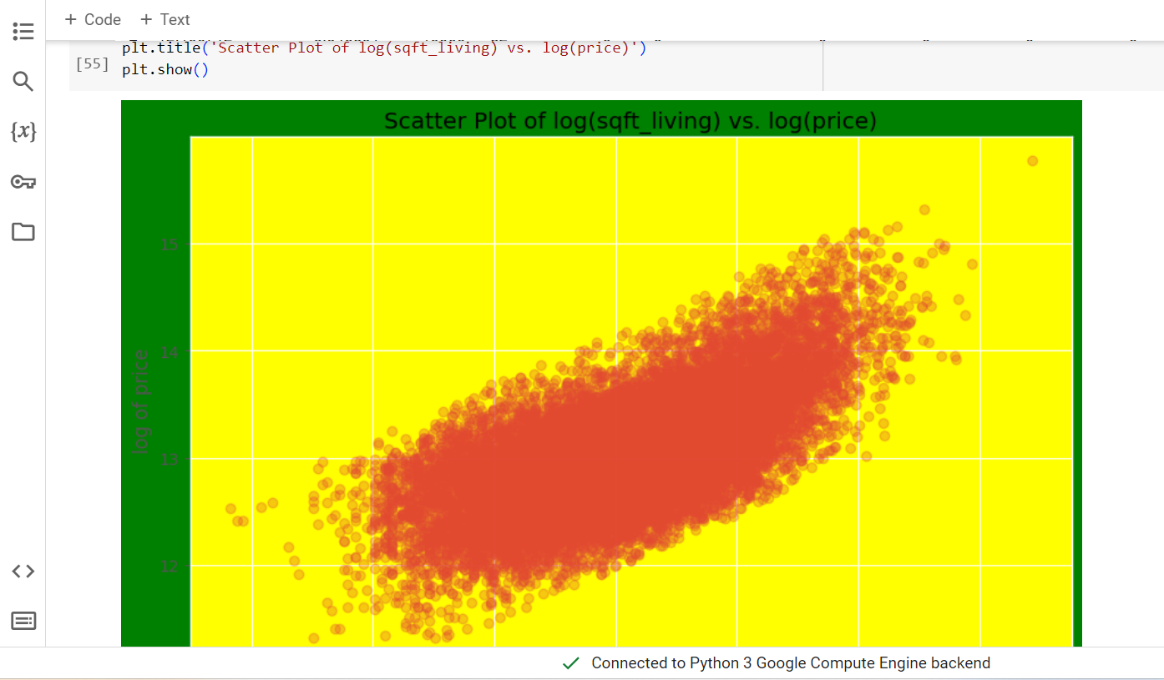

Slide 19
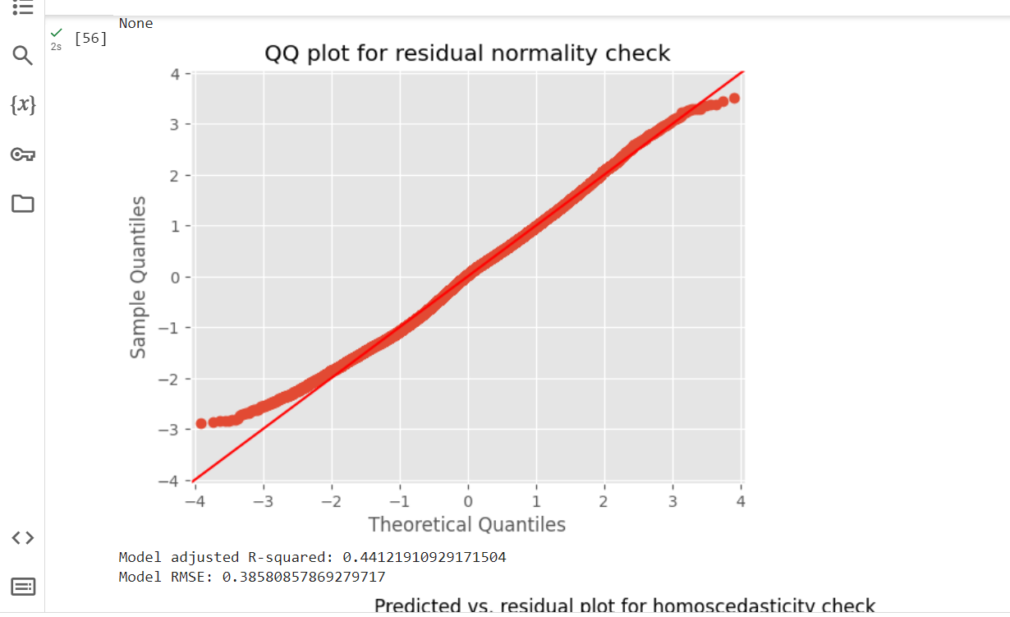

Slide 20
The regression results indicate that the logarithm of square footage of living space (log_sqft_living) is a significant predictor of the logarithm of price (log_price). Here's a summary of the regression results:
R-squared: The coefficient of determination indicates that approximately 44.1% of the variance in the logarithm of price can be explained by the logarithm of square footage of living space.

Slide 21
Coefficient Estimates:
The coefficient for log_sqft_living is approximately 0.8241, indicating that for every one-unit increase in the logarithm of square footage of living space, the logarithm of price is expected to increase by approximately 0.8241 units. The intercept (constant) term is approximately 6.8236, which represents the estimated logarithm of price when the logarithm of square footage of living space is zero. Statistical Significance: Both coefficients are statistically significant with p-values < 0.05, suggesting that they are unlikely to be zero.
Model Fit: The model's goodness of fit is indicated by the adjusted R-squared value of approximately 0.441, which is a measure of how well the independent variable explains the variation in the dependent variable.
Overall, based on these results, we can conclude that there is a strong linear relationship between the logarithm of square footage of living space and the logarithm of price.

Slide 22
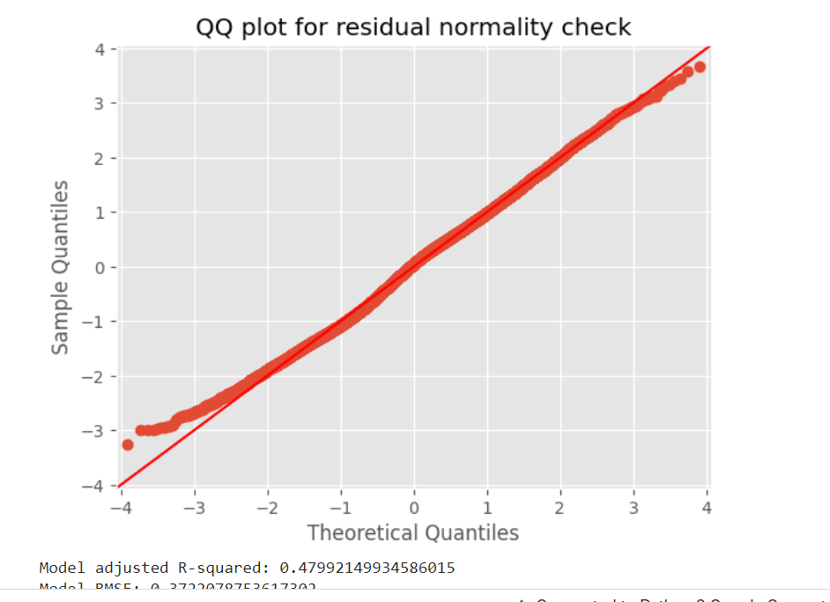

Slide 23
The updated regression results indicate that the model now includes additional predictors: waterfront, view, and renovated_last_10, in addition to log_sqft_living. Here's a summary of the updated regression results:
R-squared: The coefficient of determination has increased to approximately 0.480, suggesting that the additional predictors have improved the model's ability to explain the variance in the logarithm of price.
Coefficient Estimates:
The coefficient for log_sqft_living remains significant and has a value of approximately 0.7696. The coefficients for the additional predictors (waterfront, view, and renovated_last_10) are also significant: waterfront: Coefficient is approximately 0.5078, indicating that waterfront properties tend to have higher prices. view: Coefficient is approximately 0.2787, suggesting that properties with better views tend to have higher prices. renovated_last_10: Coefficient is approximately 0.2415, indicating that recently renovated properties tend to have higher prices. Statistical Significance: All coefficients are statistically significant with p-values < 0.05.

Slide 24
Model Fit: The adjusted R-squared value of approximately 0.480 indicates that the model with the additional predictors provides a better fit to the data compared to the previous model.
Overall, based on these results, we can conclude that the model including log_sqft_living, waterfront, view, and renovated_last_10 as predictors explains a significant portion of the variance in the logarithm of price and provides valuable insights into the factors influencing house prices.

Slide 25
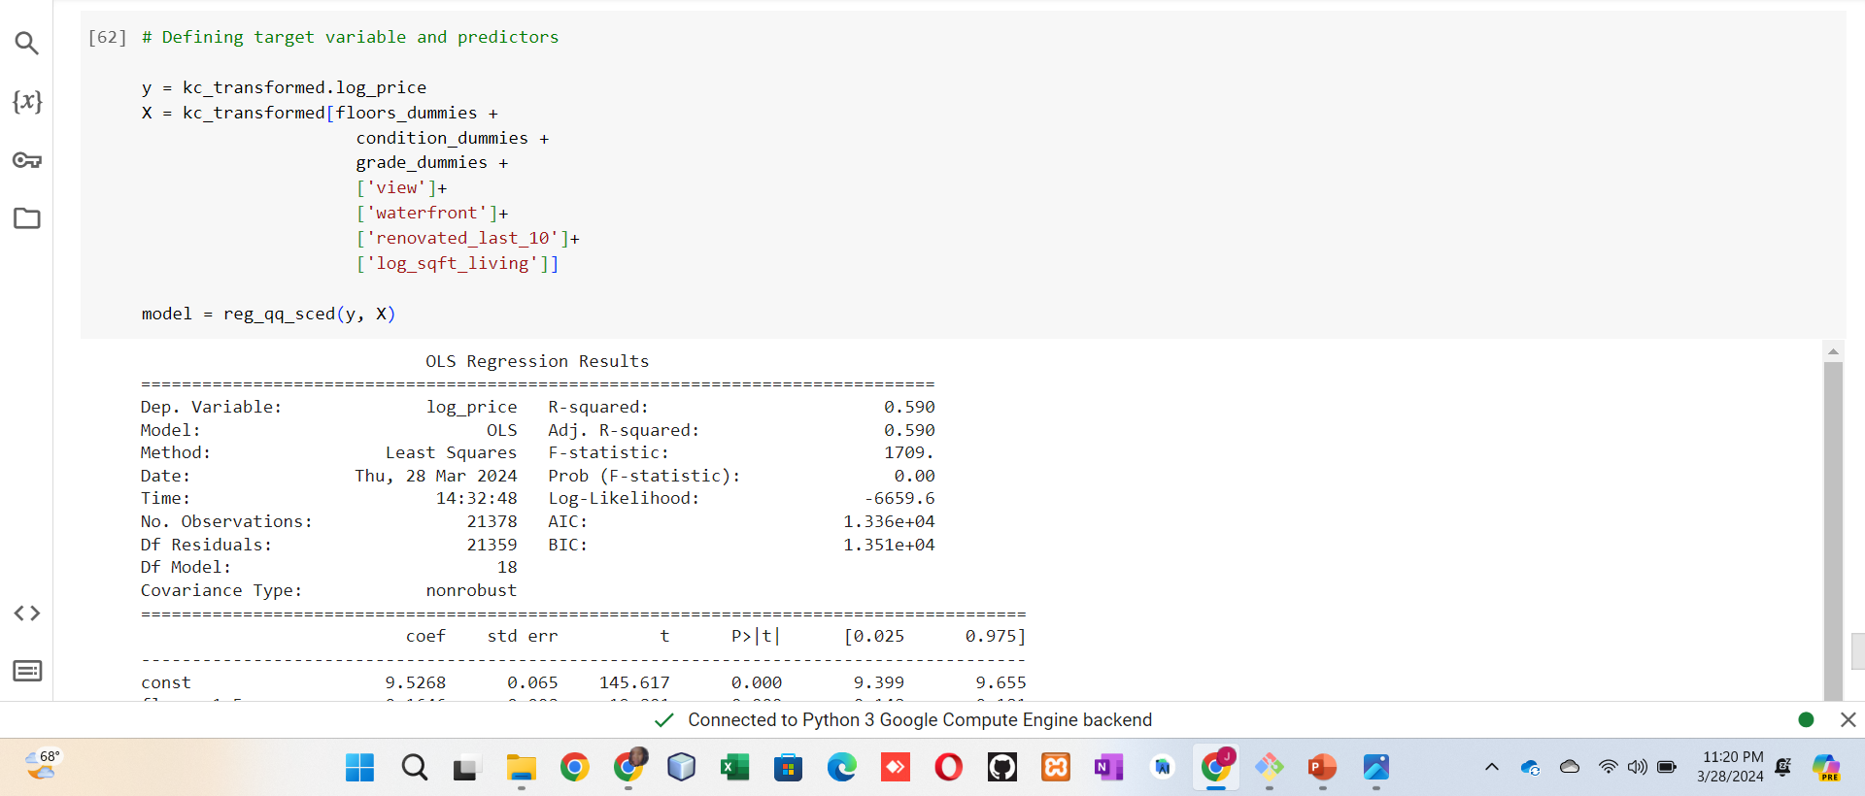

Slide 26
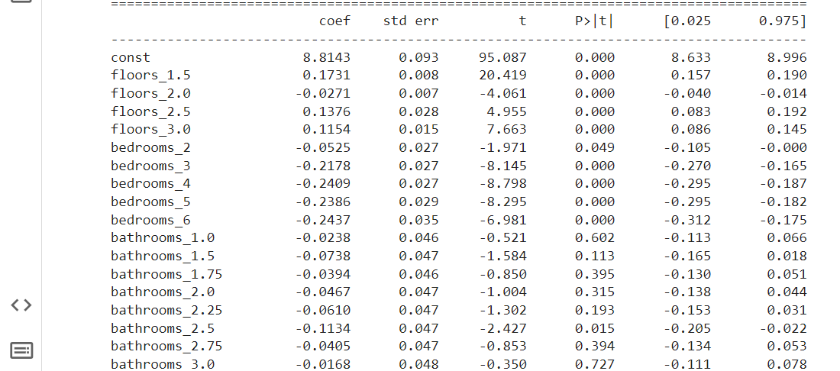

Slide 28
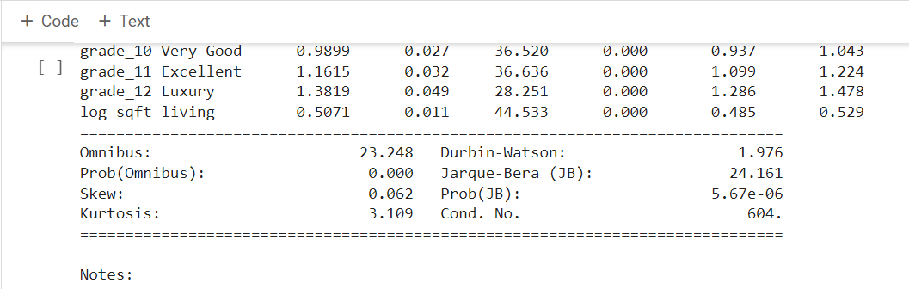

Slide 29
The regression results show the coefficients, standard errors, t-values, and p-values for each predictor in the model. Here's a summary of the results:
R-squared: The coefficient of determination, indicating the proportion of the variance in the dependent variable that is predictable from the independent variables. In this case, the R-squared value is 0.583, which means that approximately 58.3% of the variance in the logarithm of price can be explained by the predictors in the model.

Slide 30
Adjusted R-squared: A version of R-squared that adjusts for the number of predictors in the model. It penalizes excessive complexity. The adjusted R-squared value is also 0.583.
F-statistic: A measure of the overall significance of the regression model. It tests whether at least one of the predictors has a non-zero coefficient. Here, the F-statistic is 878.4, with a very low p-value, indicating that the overall model is statistically significant.

Slide 31
Coefficients: The estimated coefficients for each predictor variable. These represent the expected change in the dependent variable for a one-unit change in the predictor, holding all other predictors constant.
P-values: The p-values associated with each coefficient estimate. They indicate the statistical significance of each predictor. In this context, a p-value less than 0.05 suggests that the predictor is statistically significant.
Overall, the regression model appears to be statistically significant, with several predictors showing significant associations with the logarithm of price.

Slide 32
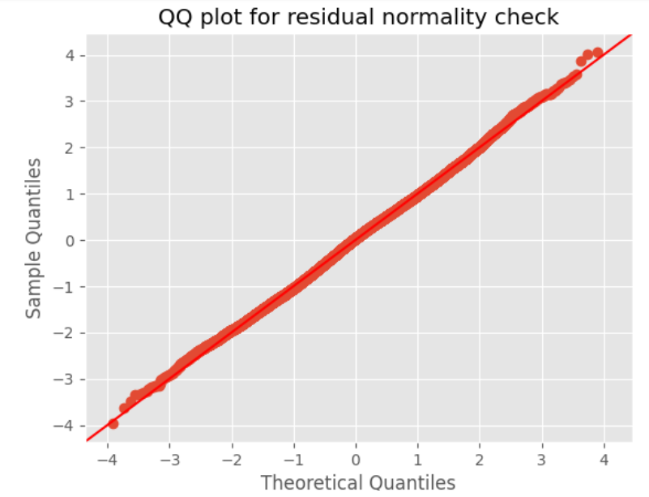

Slide 33
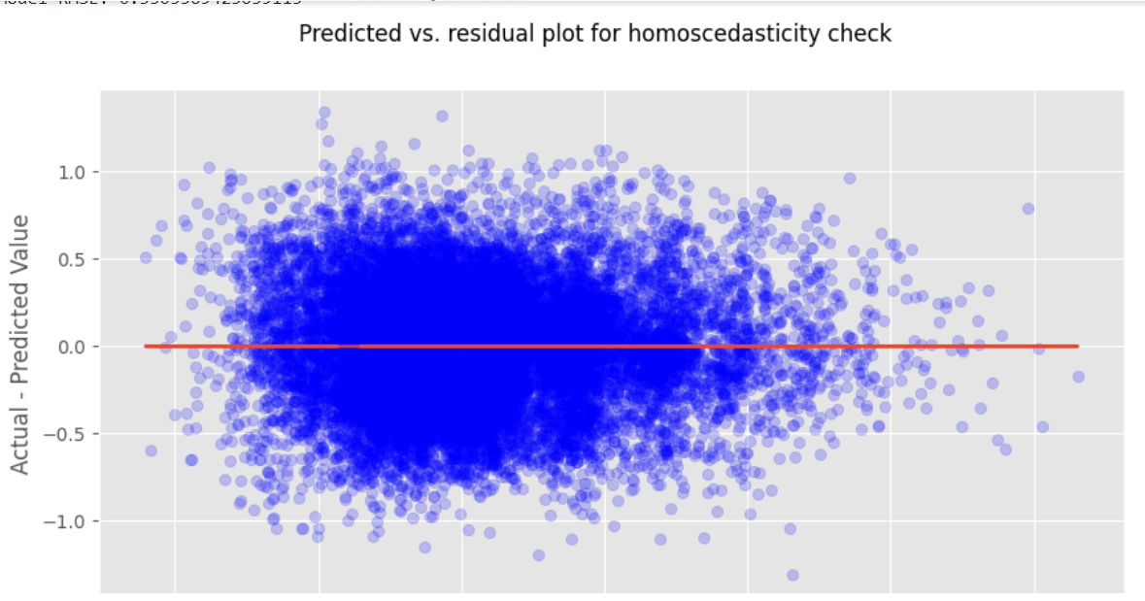

Slide 34
R-squared: The coefficient of determination is 0.590, suggesting that approximately 59.0% of the variance in the logarithm of price can be explained by the predictors in the model.
Adjusted R-squared: The adjusted R-squared value is also 0.590, indicating that the model's explanatory power is not compromised by the inclusion of additional predictors.
F-statistic: The F-statistic is 1709.0 with a very low p-value, indicating that the overall model is statistically significant.
Coefficients: The coefficients represent the estimated change in the logarithm of price for a one-unit change in the corresponding predictor variable, holding all other predictors constant. For example, a one-unit increase in log_sqft_living is associated with an increase of approximately 0.3822 in the logarithm of price.

Slide 35
P-values: The p-values associated with each coefficient estimate indicate the statistical significance of the predictors.
All predictors have p-values less than 0.05, suggesting that they are statistically significant in predicting the logarithm of price.
Overall, the model appears to be statistically significant, with several predictors showing significant associations with the logarithm of price.
Overall, the model appears to be statistically significant, with several predictors showing significant associations with the logarithm of price.

Slide 36
Observations
Observations
Observations
An observation is made based on market analysis that the property value type is the one that impact the correlation of renovation method selected.
There is strong correlation between the price and the grade since the quality of the house determines the price in which the owner will spend on renovating
Owners should give priority to the renovations that are more unique in order to be able to increase the property value.

Slide 37
Positive Effects of renovation
Renovation Impacts
Renovations Impact
Owners estimating the duration in which were constructed and lastly renovated so as to know when to decide on renovation
Renovating houses after a short duration makes it more attractive since customers will presume it as quality and durable.
Paying attention to areas such floors, bathrooms, bedrooms, and other crucial areas makes it more durable
The condition of the house gives it a proper estimate value.

Slide 38
What to give priorty
Conclusions
Providing a large area for living space. This makes a customer feel better since there is adequate space instead of congestion.
Proper maintenance. Ensuring that everything is in good condition such as no leakage, rotted wood, or rusted metals gives a convincing way for one to want to rent.
Ensuring that the house structures are quality and in current trend.

Slide 39
Recommendations
Be keen observation of the current trend
Invest in proper and quality renovations
Give priority to areas that will give you more profit
Ensure frequent maintenance
To avoid costs caused by customers’ damage during their occupation in the houses, set extra charges for every damage by customers during the stay in.

Slide 40
conclusion
Owners of real estate should be ready to take risks when it comes to the interest of the customers. They should stay ahead and know the current trends in order to boost the quality of houses and meet customers expectations.

Slide 41
Thank you!
Contact information

